Slide 1
Year 10 Pupil Information
Subject choices at Year 10
The subjects you choose in Year 10 affect what you can do in the future. You should go for a good balance of subjects to keep your career options open. Choosing subjects that suit you and your abilities is very important.

Slide 2
Choosing subjects
Watch the video below and then take the quiz to see if you understand how best to choose your subjects.

Slide 3
Year 10 subject choices quiz
Click on the image below to access the subject choices quiz.

Slide 4
Consider what sort of person you are
To help you decide what to study in Years 11 and 12, it's a good idea to start asking yourself what sort of person you are:
think about what you're like at home, as well as in school - what skills you've developed outside school
ask yourself what types of things you enjoy doing the most - for example, working things out and thinking them through, practical activities or artistic options like painting, drawing or performing music
think about what you are most interested in: it could be languages, writing projects, helping people, being outdoors or designing things

Slide 5
What you want to do
If you have a particular career in mind, or you are hoping to go to university, then it is worth finding out if there are specific subjects you need to study.
Before choosing your GCSE subjects you should be aware of choosing subjects which may affect your choices at a later stage, for example, double award science is essential for careers related to medicine but it will also give you many other options.
To learn more about the various careers and the qualifications required why not check out the Careers A-Z below.
Careers A-Z
You might be unsure of what you want to do yet and that's fine. It just means you need to keep your options open when you're choosing your subjects. To help you start matching your interests, skills and values with jobs, you could use the career matching tool Career Ideas.
Career discovery (Xello for 11 to 19 year olds)

Slide 6
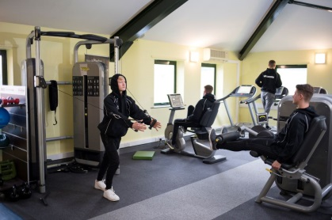
How you like to learn
Studying in Years 11 and 12 isn't just about GCSEs. Depending on what's available at your school, you may be able to choose from vocational qualifications which are work-related.
Subjects are taught in different ways and it may be that one teaching method suits you more than another.

Slide 7
Exam Boards
Exam Board | Method of Assessment
CCEA | Exams / Coursework / Practical's
BTEC | Portfolios / Exams
OCR | Portfolios / Exams
OCN | Portfolios
Princes Trust | Portfolios
YMCA | Portfolios
BUT YOU NEED TO BE VERY CAREFUL WITH YOUR CHOICES BECAUSE NOT ALL QUALIFICATIONS ARE ACCEPTED BY ALL UNIVERSITY’S
GCSE equivalent qualifications are accepted by some universities as an alternative to full GCSEs, but they may not have been recognised by employers and professional bodies.
Making the wrong subject choices can have a major impact on your choices in the future so choose wisely!

Slide 8
University of Ulster - Specific information is on each course page as this can vary from course to course. We don’t accept any OCN Level 2 qualifications as satisfying these requirements.
Queens University - BTEC/OCR qualifications at Level 2
In fulfilment of the General Entrance Requirement or where performance at GCSE level is used in the selection process for individual programmes the University will accept a maximum of one BTEC/OCR qualification at Level 2. Normally a maximum of the equivalent of four GCSEs in acceptable vocational qualifications will be counted.
https://www.ulster.ac.uk/study/entrance-requirements
https://www.qub.ac.uk/Study/Undergraduate/How-to-apply/general-entrance-requirements/

Slide 9
Making choices
You'll have many options in Year 10, but there are some subjects so important that everyone has to take them. English and Maths are the subjects most often required for courses and careers. Doing as well as you possibly can in Maths and English will improve your chances of getting a job or course at a later stage.
For subjects you can choose you should:
make sure that you have accurate and up-to-date labour market information - https://www.lmiforall.org.uk/
talk to those who can give you good reliable advice such as your careers teacher/adviser - https://www.nidirect.gov.uk/services/chat-with-a-careers-adviser
discuss the options with your family and subject teachers

Slide 10
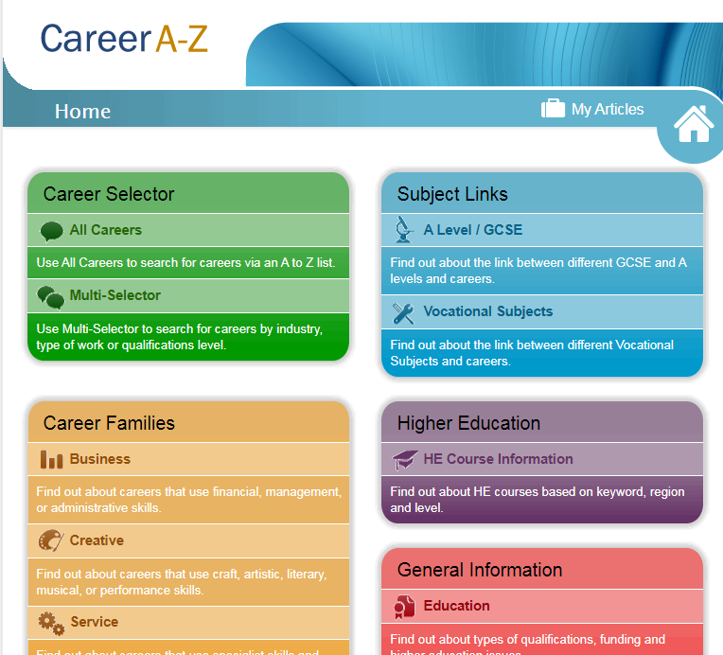
Choosing the subjects you need
If you know what career you want, choosing the right subjects can be critical. For example, if you are considering following a science pathway you will need at least double award science.
Click on the image below to access Careers A-Z

Slide 11
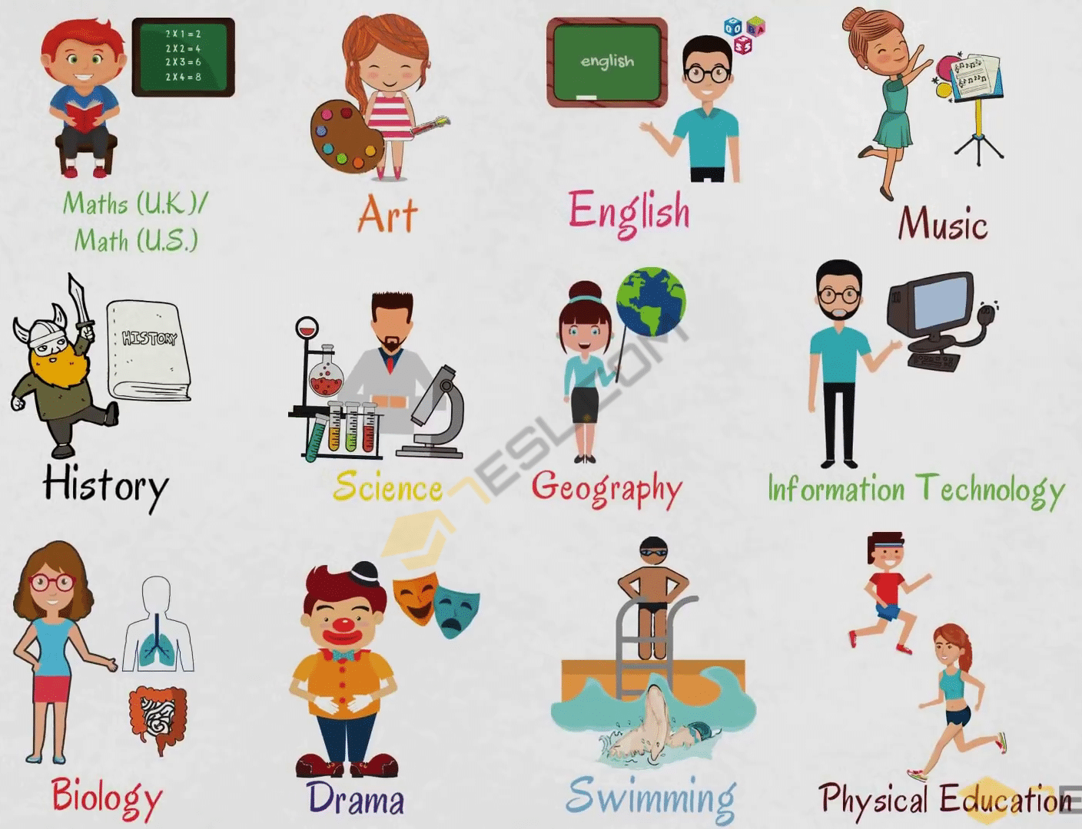
Choosing the subjects you like and are good at
Nearly everyone gets better marks in subjects they enjoy and are good at. You should take this into account, but always keep in mind your preferred course or career when you leave school.
Click on the link https://www.nidirect.gov.uk/articles/careers-online-support to access Careers Online Support

Slide 12
What to avoid
You shouldn’t choose subjects for the wrong reasons, for example:
you like the teacher – the teacher may change
there isn’t much homework – that will change
your friends are taking the subject – it might be right for them, but not for you

Slide 13
Interests and aptitude
You may already know what you hope to do after your GCSEs. Although it may be too early to make final career decisions, you may have an idea of the broad area, which interests you, for example, clerical, active, social, practical, scientific or artistic for example. Some subjects may be more relevant to one area than to another.

Slide 14
Where you can get help and advice
When it comes to choosing subjects and careers, you'll find there are many people ready to help you, but it's important for you to do as much as you can to check out all the options.
For help and information, speak to:
a careers adviser from the Careers Service
a subject teacher as they know exactly what studying a subject in Year 11 and 12 will involve and can advise you whether it's right for you
a careers teacher as they can tell you which subjects and qualifications are suitable for certain careers
a special educational needs coordinator (SENCO) as this is the person at your school who can arrange support if you have a disability or learning difficulty which affects your studies
a volunteer or learning mentor who can help you to overcome the things that are getting in the way of your learning so ask if there is one at your school
parents, carers, family and friends probably know you best and understand your strengths and weaknesses so talking to them can help you work out what subjects might best suit your skills and interests
Careers Service

Slide 15
Chat with a Careers Adviser
Careers webchat is available from 9.30 am to 4.30 pm. Outside of these hours, or if all advisers are busy, you can ask questions online.
Click on the image below to chat to a Careers Adviser

